Slide 1
BASIC COMMANDS IN MATLAB
Arithmetic Operations
Order of Precedence
Math Functions
Trigonometric Math Functions
Predefined Variables

Slide 2
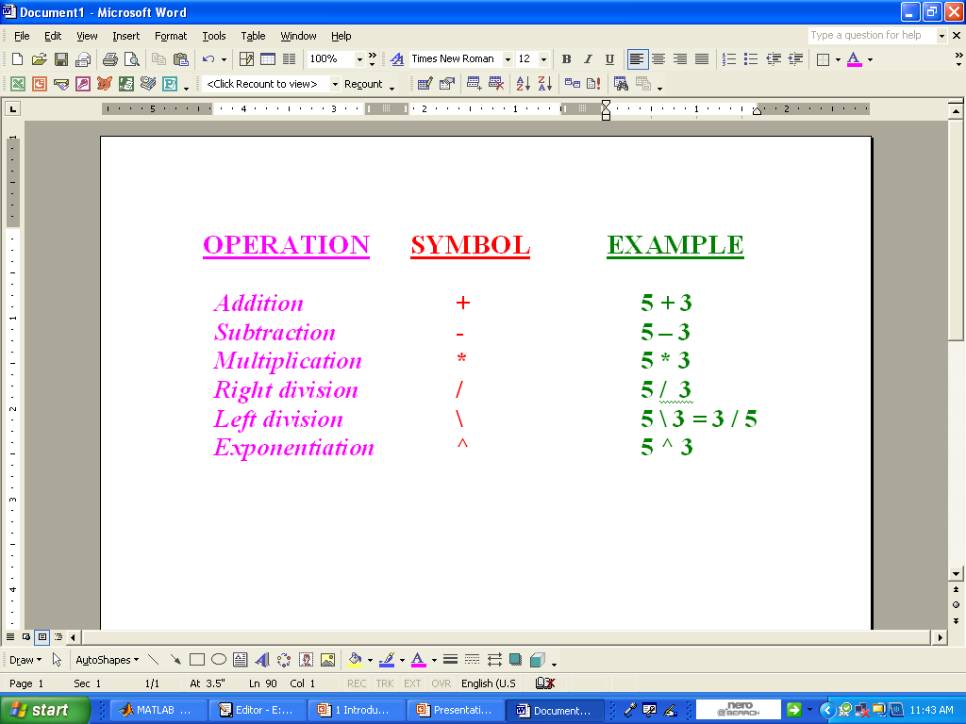
Arithmetic Operators

Slide 3
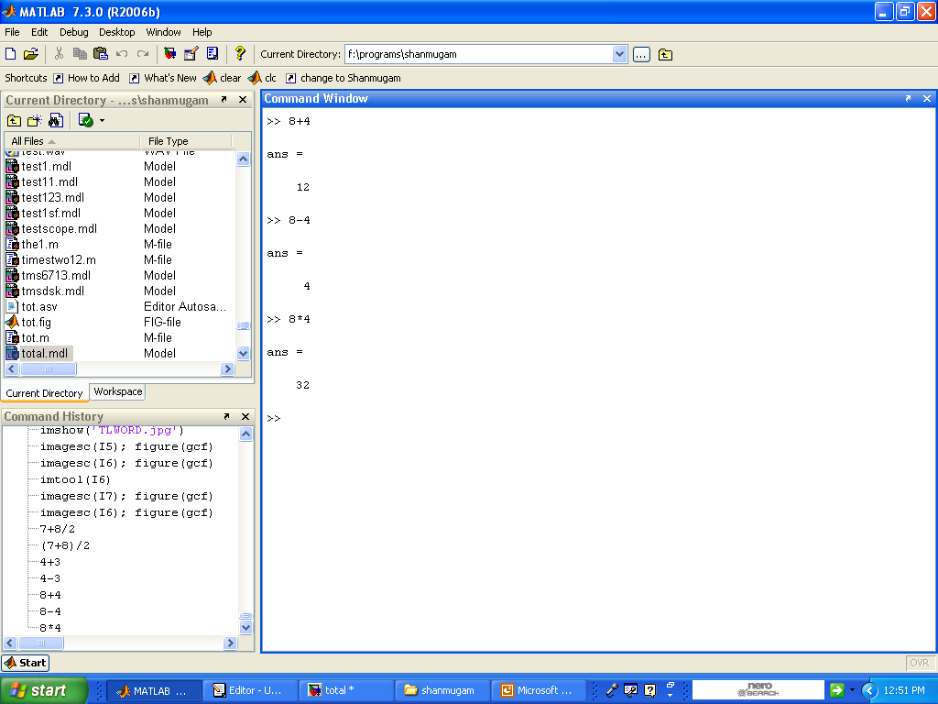
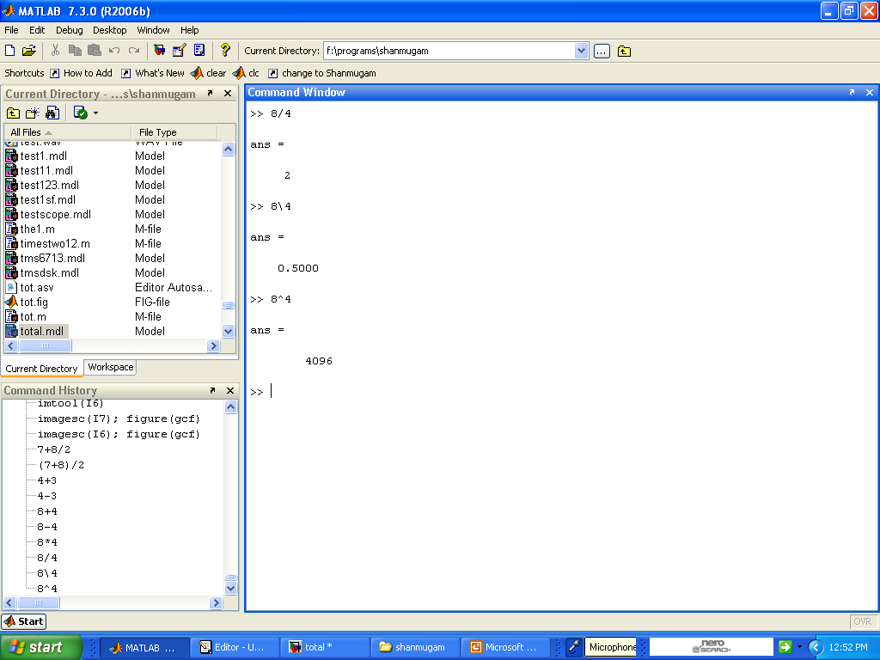
Example:-

Slide 4
Order of Precedence
Precedence Mathematical Operation
First Parentheses.
Second Exponential.
Third Multiplication, Division.
Fourth Addition and Subtraction

Slide 5
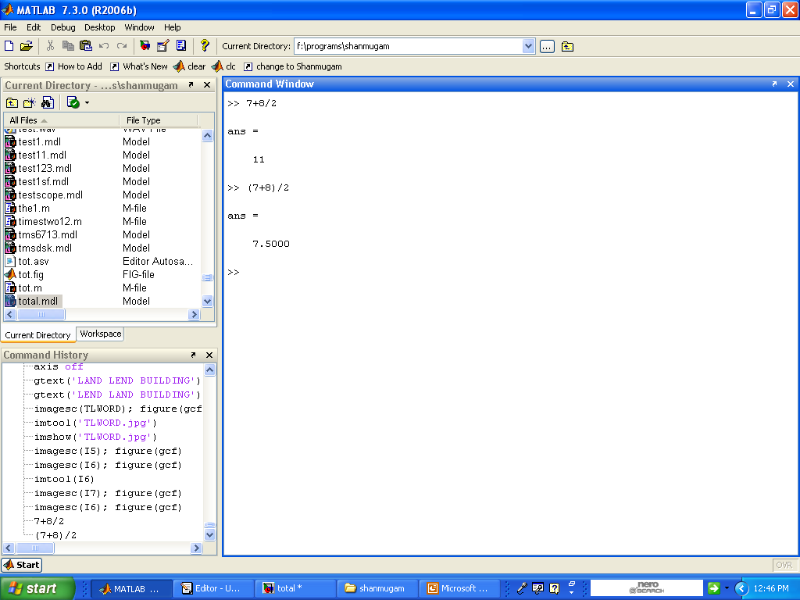
Example:-
8/2 is executed first
7+8 is executed first

Slide 6
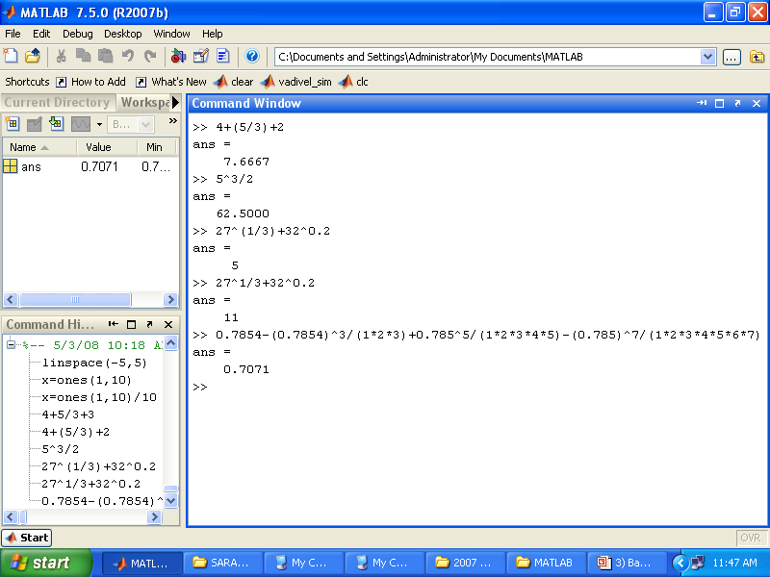
Type and press Enter
5/3 is executed first
5^3 is executed first,/2 is executed next

Slide 7
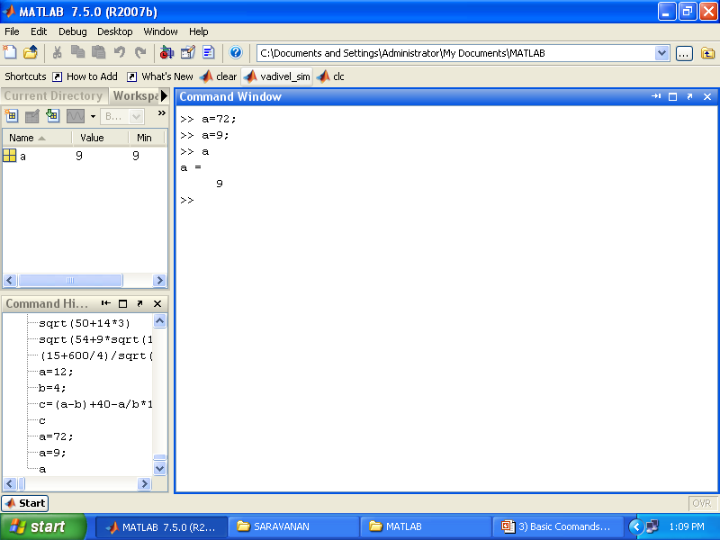
A value of 72 is assigned to the variable a.
A new value of 9 is assigned to the variable a.
The current value of the variable is displayed when the name of the variable is typed and the Enter key is pressed

Slide 8
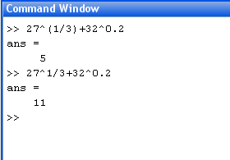
1/3 is executed first,27^(1/3) and 32^0.2 are executed next, and + is executed last
27^1 and 32^0.2 are executed first, and /3 is executed next + is executed last

Slide 9
Mathematical Functions
Function Description
sqrt(x) Square root.
exp(x) Exponential.
abs(x) Absolute value.
log(x) Natural logarithm.
log10(x) Base 10 logarithm
factorial(x) The factorial function x!

Slide 10
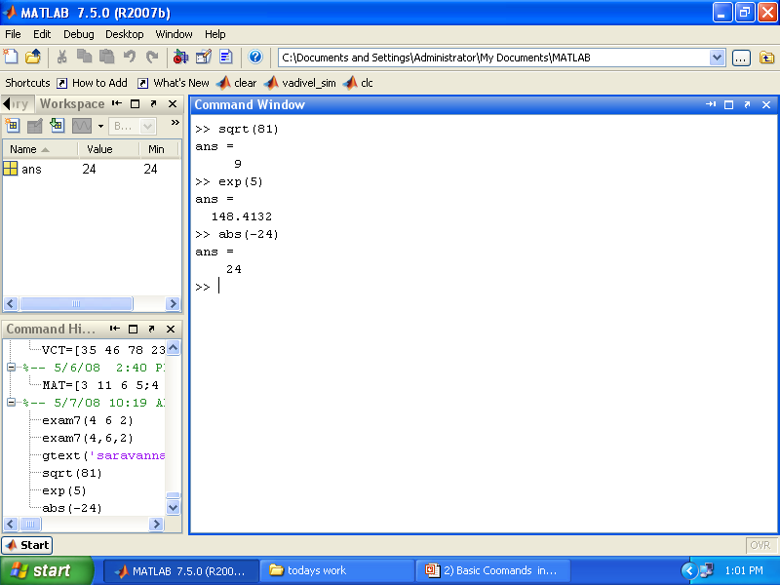
Mathematical Functions
Square root
Exponential (exp)
Absolute value

Slide 11
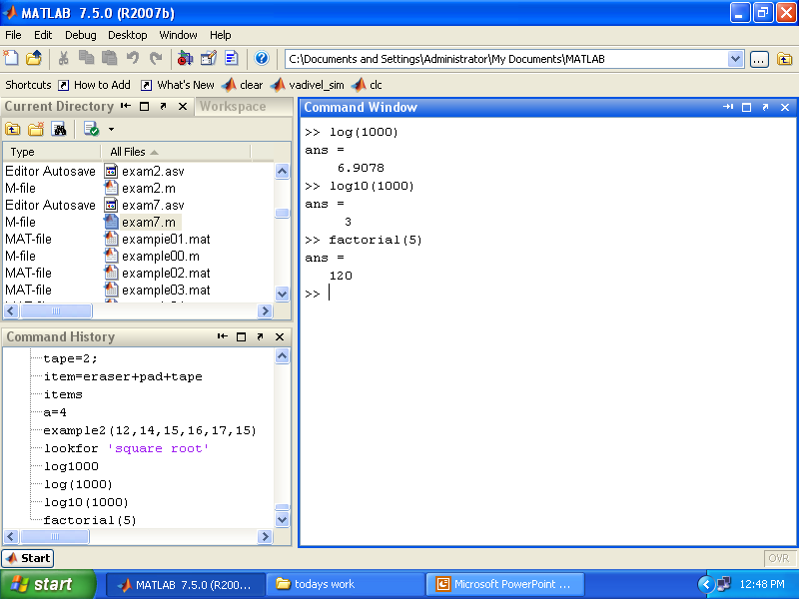
Natural logarithm base e logarithm log(x)
Base 10 logarithm
The factorial function(x)

Slide 12
Trigonometric Functions
Function
sin(x) x→ radians
cos(x)
tan(x)
cot(x)

Slide 13
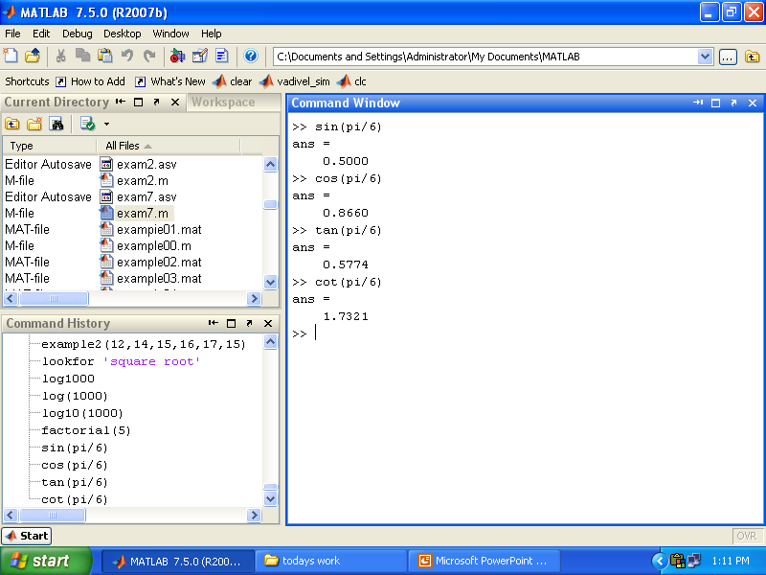
Trigonometric Functions
Sine of angle x (x in radians)
Cosine of angle x (x in radians)
Tangent of angle x (x in radians)
Cotangent of angle x (x in radians)

Slide 14
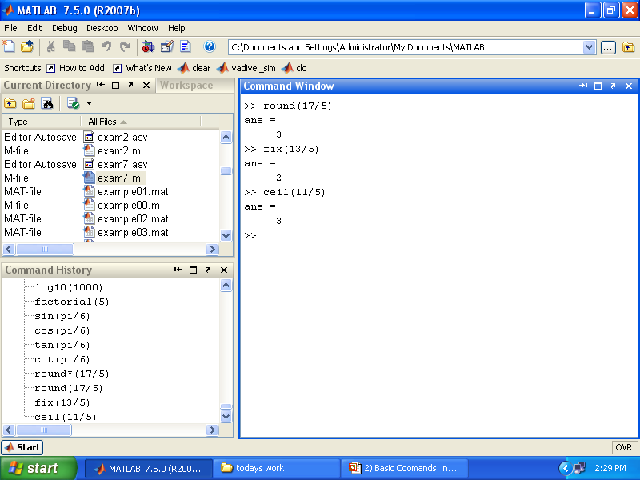
Rounding Functions
Round to the nearest integer
Round towards zero
Round towards infinity

Slide 15
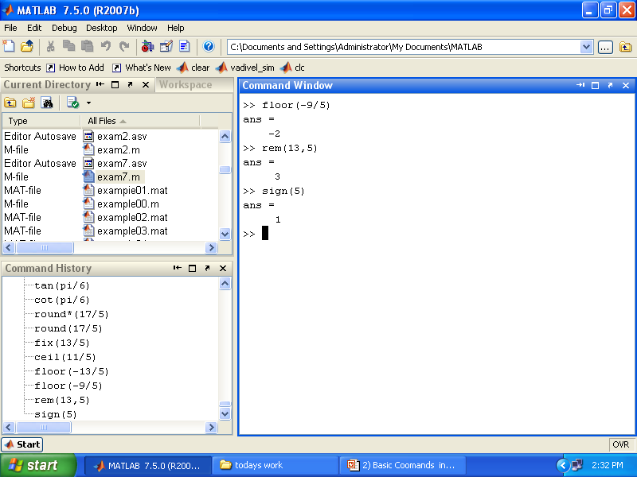
Round towards minus infinity
Returns the remainder after x is divided by y
Signum function Returns 1 if x>0,-1 if x<0,and 0 if x=0

Slide 16
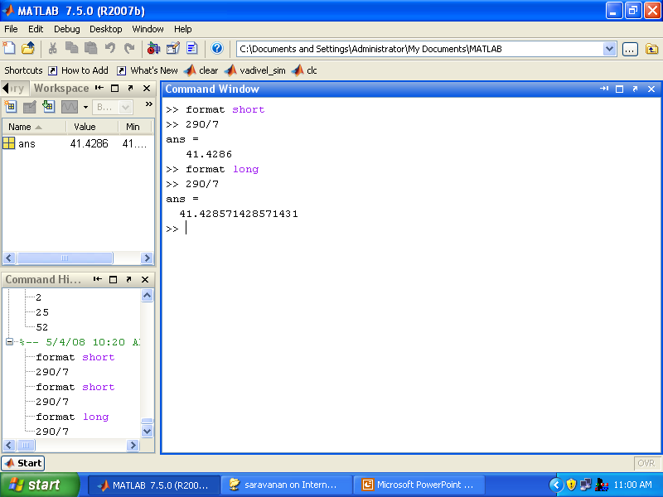
Display Format
Fixed-point with 4 decimal digits for:0.001<number<1000 otherwise display format short e
Fixed-point with 14 decimal digits for:0.001<number<100 otherwise display format long e

Slide 17

Scientific notation with 4 decimal digits
Scientific notation with 15 decimal digits

Slide 18
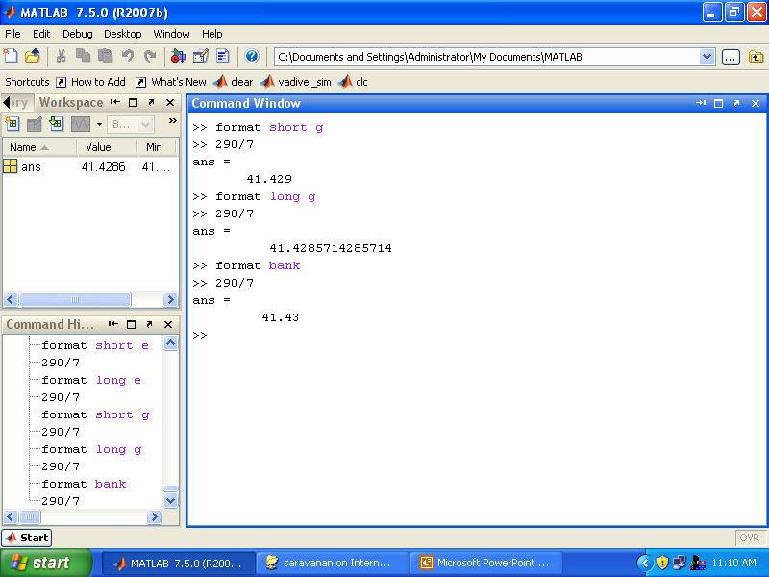
Best of 5-digit fixed or floating point
Best of 15-digit fixed or floating point
Two decimal digits

